Slide 1
Visual Analytics for Explainable Machine Learning

Slide 2
Recent ML Systems Achieve Superhuman Performance
AlphaGo beats Go human champ
Deep Net outperforms humans in image classification
Deep Net beats human at recognizing traffic signs
DeepStack beats professional poker players
Autonomous search-and-rescue drones outperform humans
Medical-ECG classification……

Slide 3
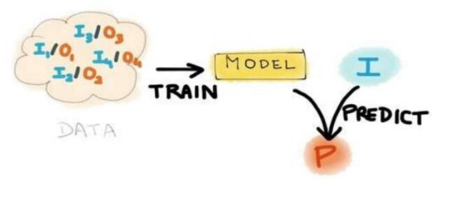
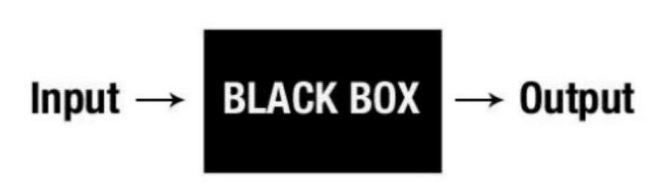
Machine Learning as a Black Magic or Black Box
Most machine learning processes are NP-processes

Slide 4
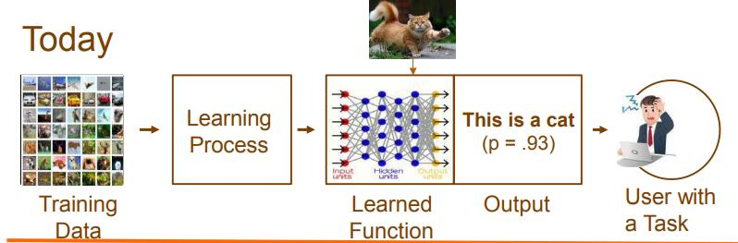
Explainable AI – What Are Trying To Do?
Why did you do that?
• Why not something else?
• When do you succeed?
• When do you fail?
• When can I trust you?
• How do I correct an error?

Slide 5
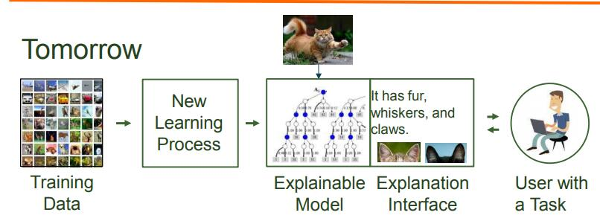
Explainable AI – What Are Trying To Do?
I understand why
I know when you’ll succeed
• I know when you’ll fail
• I know when to trust you U
• I know why you erred

Slide 6
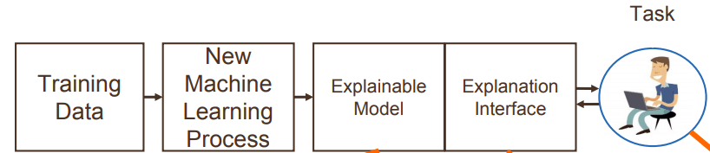
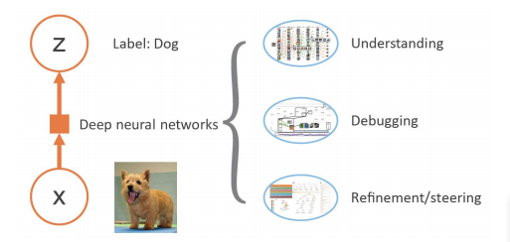
Explainable Artificial Intelligence (XAI)
Explainable Models
Explanation Interface
Psychology of Explanation
OVERVIEW OF EXPLAINABLE DEEP LEARNING

Slide 7
Explainable Models ：develop a range of new or modified machine learning techniques to produce more explainable models
Explanation Interface ：integrate state-of-the-art HCI with new principles, strategies, and techniques to generate effective explanations
Psychology of Explanation：summarize, extend, and apply current psychological theories of explanation to develop a computational theory

Slide 8

Machine Learning Pipeline
Solution = Data + ML Expertise + Computation
Tasks
– Preprocess and clean the data
- Select and construct appropriate features
- Select an appropriate model family
- Optimize model hyperparameters
- Postprocess machine learning models
- Critically analyze the results obtained

Slide 9
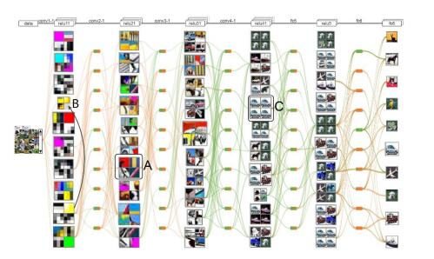
CNNVIS
Figure 3. Overview of CNNVis [8]. The system employs a DAG to visually illustrate the inner workings of a CNN training process. It also performs biclustering to visualize the strength of interactions between filters of adjacent layers, along with their most activated images.

Slide 10
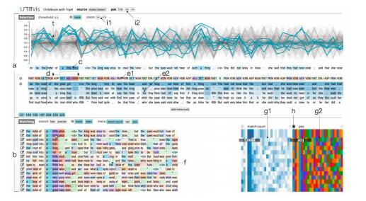
LSTMVIS
Figure 4. Overview of LSTMVis [10]. Given a sequential input, e.g., words in a document, the line graphs in the top panel visualize the activation patterns of individual hidden nodes over the sequence. Once a user selects a sub-sequence containing multiple words, e.g., the noun phrase "a little prince," and specifies a threshold, the system identifies those hidden nodes exhibiting activation values greater than the threshold and finds other sub-sequence examples for which the same hidden nodes have high
activation values. These subsequences allow users to interactively explore the learnt behavior of hidden nodes.

Slide 11
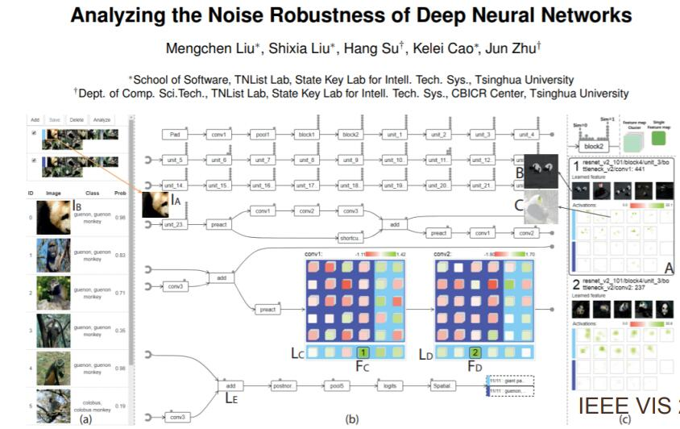
Data is the King of Machine Learning!
Adversarial Examples
• Intentionally designed to mislead a deep neural network (DNN) into making incorrect prediction

Slide 12
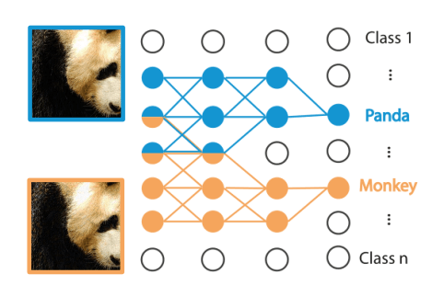
Technical Challenges
• Extract the datapath for adversarial examples Normal example
• Datapath visualization
A datapath
Hundreds of layers
Millions of neurons
Millions of connections

Slide 13
Datapath Extraction - Motivation
• Current method
• Most activated neurons
• Problem
• Misleading results when existing a highly recognizable secondary object
• Reason
• Neurons have complex interactions
• Gap between activation and prediction

Slide 14


Datapath Extraction - Formulation
• The critical neurons for a prediction: the neurons that highly contributed to the final prediction
• Subset selection
– Keep the original prediction by selecting a minimized subset of neurons
• Extend to a set of images X

Slide 15

Datapath Extraction - Solution
• Directly solving: time-consuming
– NP-complete ：Quadratic approximation
– Large search space due to the large number of neurons in a CNN ：Divide-and-conquer-based search space reduction
An accurate approximation in smaller search space

Slide 16
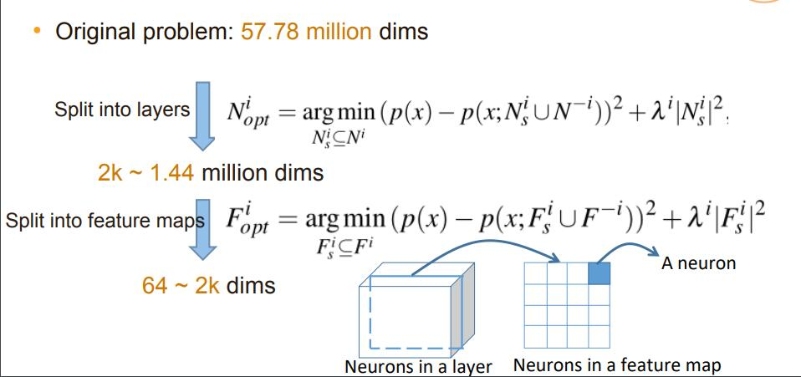
Datapath Extraction – Search Space Reduction

Slide 17
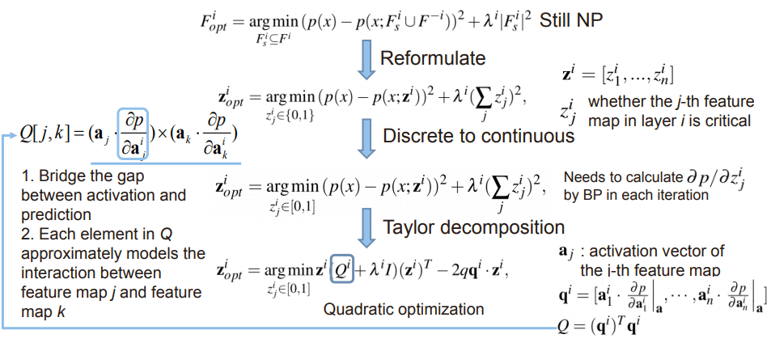
Datapath Extraction – Quadratic Approximation

Slide 18
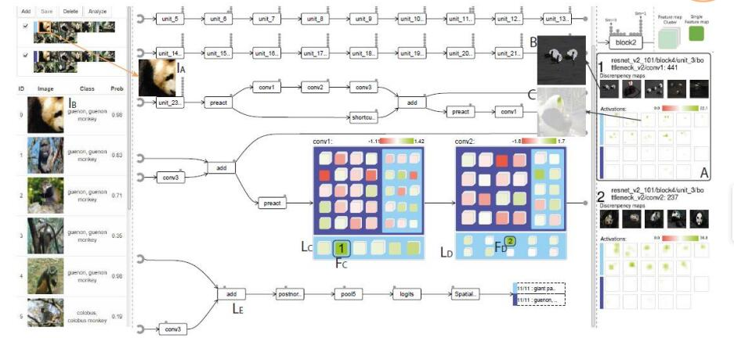
Datapath Visualization

Slide 19
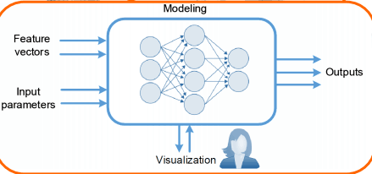
Visualization and Machine Learning pipeline
Large model, but sparsely activated Single model to solve many tasks

Slide 20
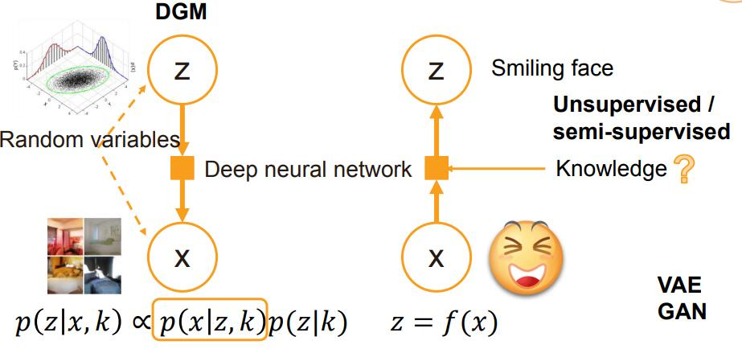
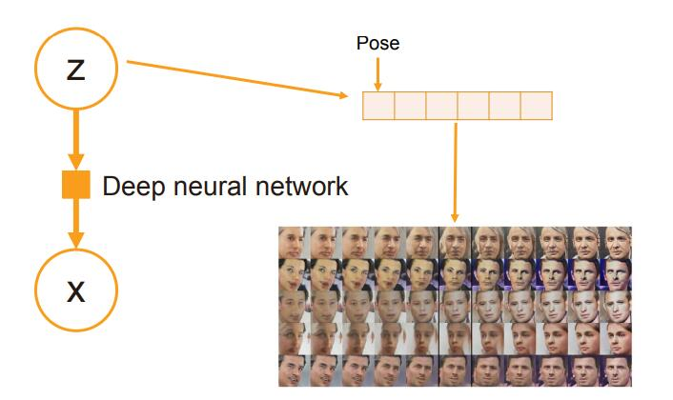
Analyzing the Training Processes of Deep Generative Models

Slide 21
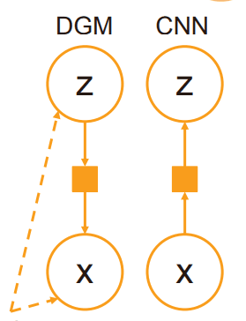
Training a DGM is Hard
• DGM often involves both deterministic functions and random variables
– CNN: deterministic functions (e.g., convolution)
• DGM involves a top-down generative process and a bottom-up Bayesian inference process
– CNN: a bottom-up process: input at the bottom layer -> high-level features -> outputs
Random variables

Slide 22
Challenges
• Handle a large amount of time series data
– Millions of activations/gradients/weights in a DGM
• Identify the root cause of a failed training process
– Errors may arise from multiple possible sources: abnormal training samples, inappropriate network structures, and lack of numerical stability in the library
– Even when we can determine that the error is caused by the network structure, it is often difficult to locate the specific neurons

Slide 23
Our Solution
• A blue noise polyline sampling algorithm
– Selects polyline samples the with blue-noise properties
– Preserves outliers and reduce visual clutter
• A credit assignment algorithm
– Discloses how other neurons contribute to the output of the neuron of interest

Slide 24
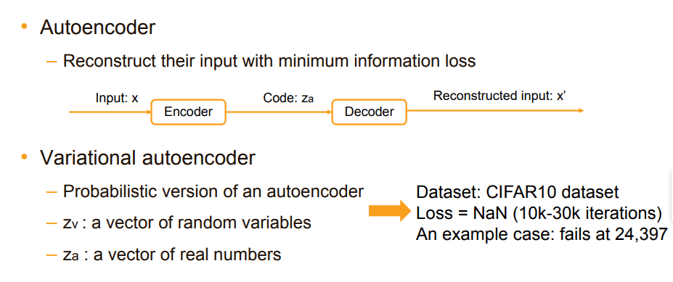
DGMTracker
• Better understand and diagnose the training process of a DGM
Case Study: Debugging a Failed Training Process of a Variational Autoencoder (VAE)

Slide 25
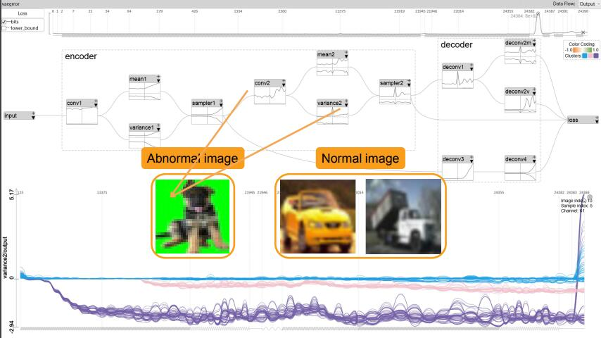

Slide 26
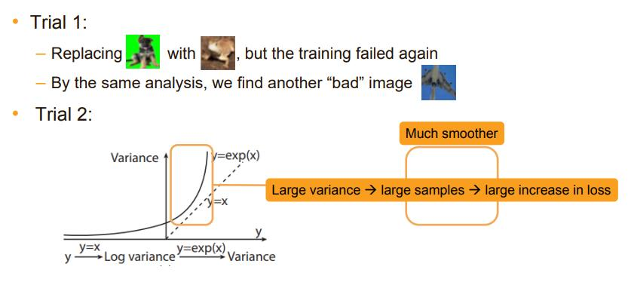
Solution

Slide 27
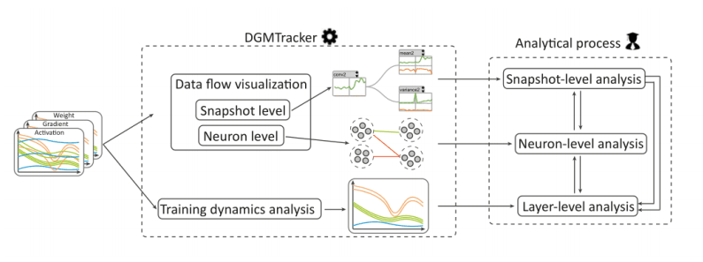
DGMTracker

Slide 28
RESEARCH GAPS AND OPPORTUNITIES
Injecting external human knowledge
Progressive visual analytics of deep learning
User-driven generative models
Improving the robustness of deep learning for secure artificial intelligence
Reducing the size of the required training set
Visual analytics for advanced deep learning architectures

Slide 29
Research Opportunities
• Human-in-the-loop visual analytics for practitioners
– Existing deep learning models are data-driven
– Combine human expert knowledge and deep learning techniques through interactive visualization
• Progressive visual analytics of deep learning models
– The training of many deep learning models is time-consuming
– Progressive visual analytics techniques are needed

Slide 30
Research Opportunities (Cont’d)
• Improving the robustness of deep learning models for secure artificial intelligence
– Deep learning models are generally vulnerable to adversarial perturbations
– Incorporate human knowledge to improve the robustness of deep learning models
• Reducing the size of the required training set
– One-shot learning or zero-shot learning
• Visual analytics for advanced deep learning architectures
– ResNet and DenseNet

